Slide 2
Agenda
Business Case
Revised Understanding
Key Questions
Roadmap Versions and Features
Recommendation
Interim Delivery
Next Steps

Slide 3
Business Case
Deliverables
  Migrated Omiga
  Re-Architected Supervisor within same timeframe
    Service Orientated Architecture
    Separate Application
  Recommended End State for Omiga

Slide 4
Revised Understanding
Focussing on end state shows Omiga will change:
  Service Orientated Architecture
  Each service can be separately deployed with its own configurable elements
  Logically separate data structures to support each service
  Single, flexible, customisable UI (thin client)
  Single framework for Omiga and its configuration
Therefore re-architecting Supervisor now will not match Omiga end state
  Timescales for return of migrated code prevent any changes to Omiga
  Re-architecting now constrains us to support migrated Omiga code and database
  Omiga business enhancements will change both Omiga and Supervisor.
  e.g. generic fee sets, branding
  In the end state, Supervisor functionality is absorbed into the Omiga services and UI.
  i.e. Supervisor will not be a separate application
Cannot deliver re-architected Supervisor in 500 days
  Proof of concept produced revised Supervisor re-architecture estimates

Slide 5
Key Questions
Re Architect or Migrate Supervisor?
SOA depth or width first?
    Depth – end to end SOA service
    Width – full service layer
Notes:
Width
Single UI
Appearance of services
Min changes to clients
Not Full E to E Service
More analysis and Design required up front
More development work required
Depth
E to E Service
Quicker to develop
More Integration
Plug ability
More impact on existing clients
Multi UI
Not Full Service layer

Slide 6
Roadmap Versions
Version 4 Current
  VB 6 Omiga and Supervisor
Version 5 .NET
  .NET Supervisor and Omiga
  Support SQL Server 2005
  Support for IE7
Version 6 Partial SOA
Version 7 Full SOA

Slide 7
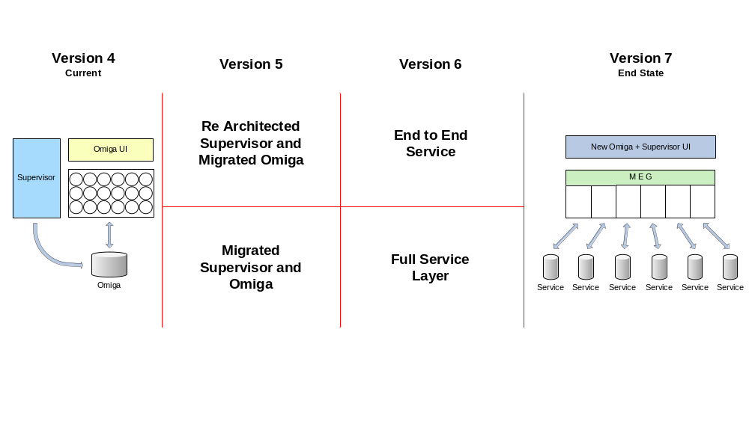

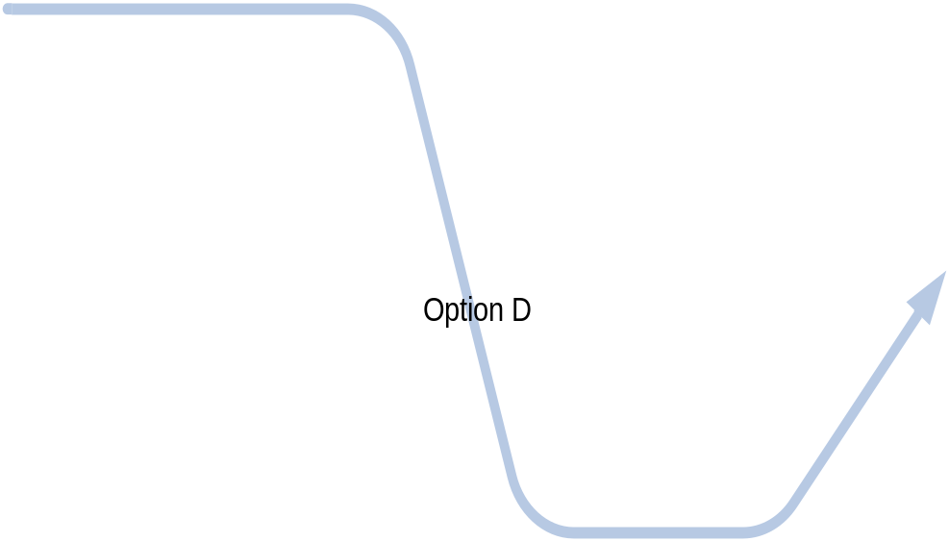
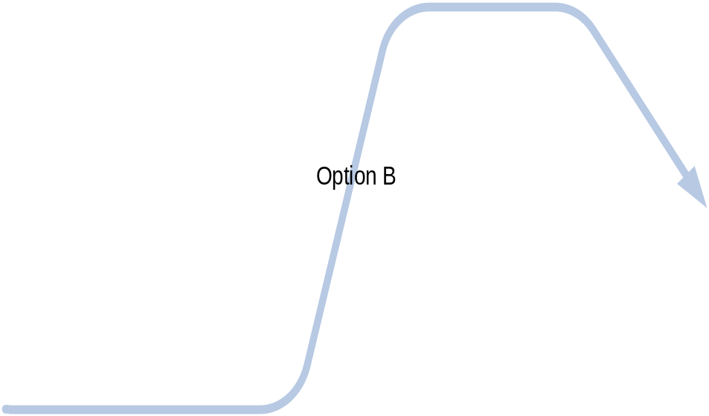

Options Overview
Notes:
4 Routes to Omiga End State
A. Migrate Supervisor + Service Layer
B. Migrate Supervisor + End to End Service
C. Re Architect Supervisor + End to End Service
D. Re Architect Supervisor + Service Layer

Slide 8
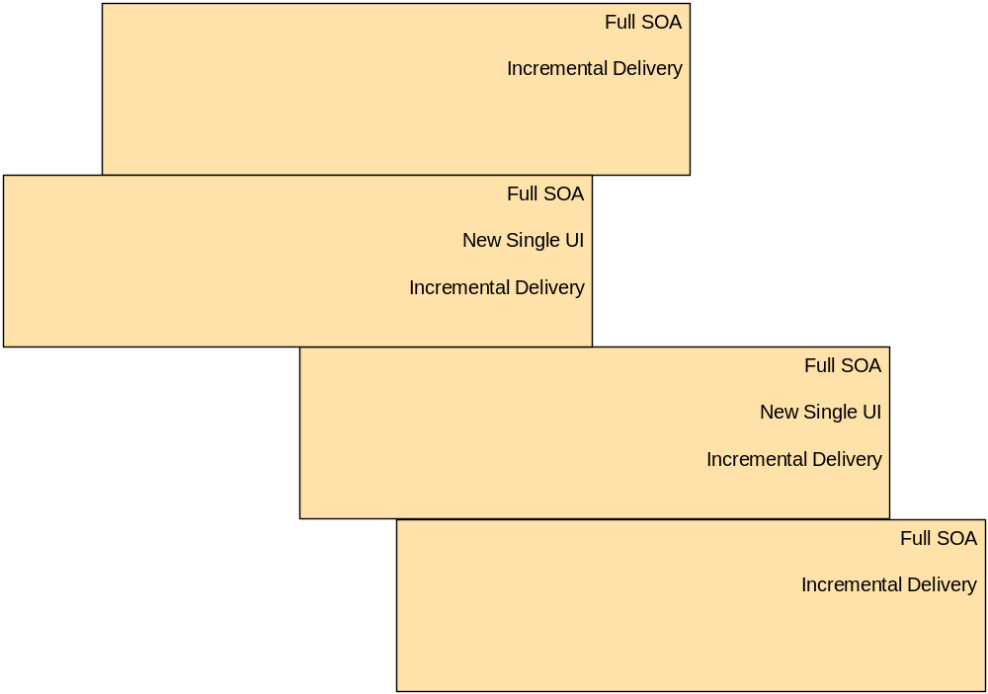
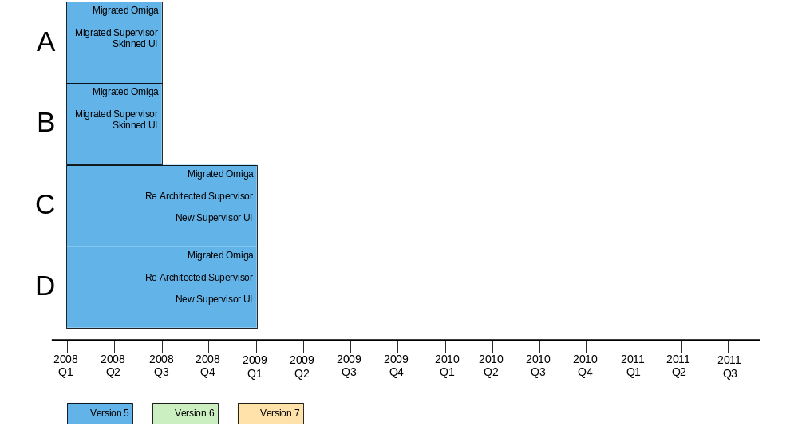
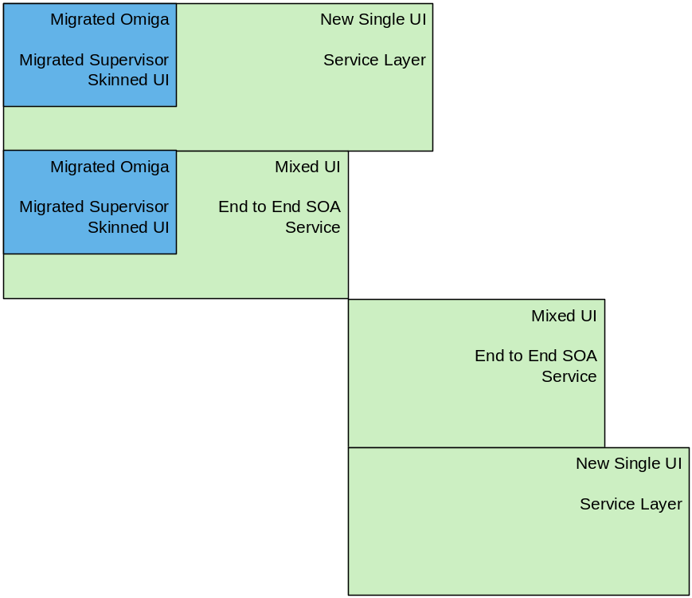
Illustrative Feature Timeline

Slide 9
Evaluation Criteria
Earliest to .NET
Least throwaway Vertex work
Earliest to service layer
Earliest to a full SOA service
Earliest to new single UI
Easiest to add BAU updates
Earliest to end state

Slide 10
Recommendation
Option A
  Migrate Supervisor
    .NET delivered quicker than re-architecture
    Least delivery risk for version 5 as outsourced to AiS
    Can deliver to current Product clients
    Refreshed UI
    Simplified deployment
    Least rework of Supervisor
    Staff training not on critical path for first version
  Start version 6
    Work can start in parallel
    Create Full service layer
    Full new consistent UI

Slide 11
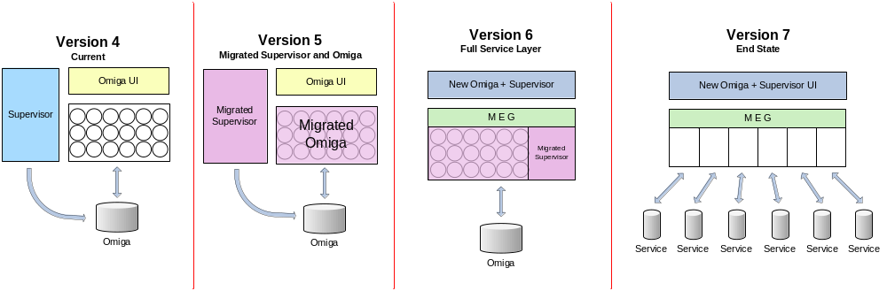
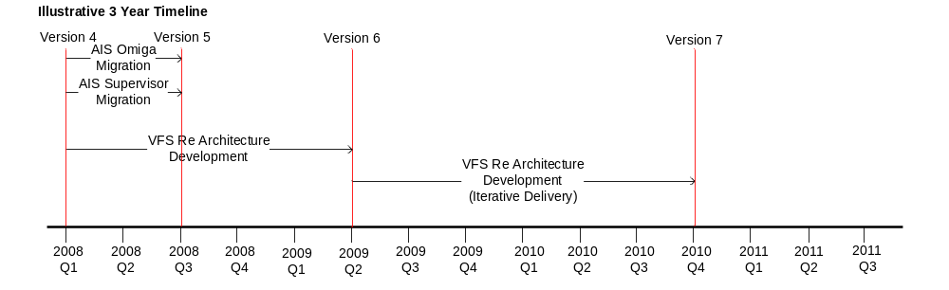
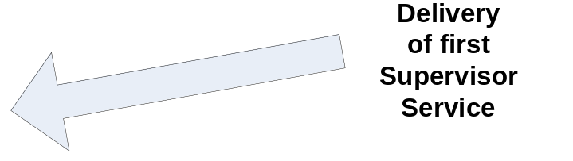
Option A

Slide 12
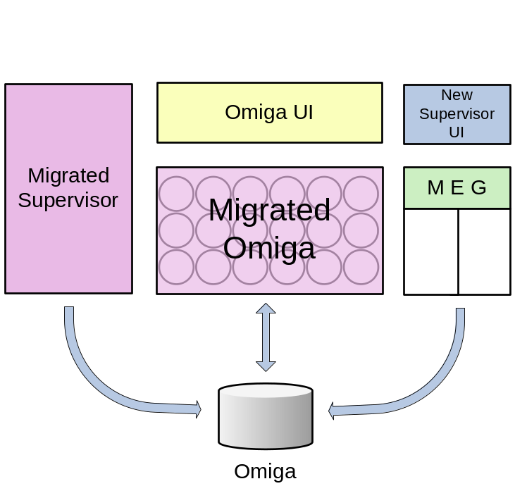
Interim Supervisor Delivery
Estimate
  343 Person days
  Excludes BAU changes
  Excludes remainder of re architected Supervisor
  Excludes Supervisor Migration
Risks and Issues
  May not match End State
  May not meet Deadline
  May not meet Client expectation
  Will delay the delivery of the next version
  Will introduce additional throwaway development
Deliverables
  Product Configuration
  New UI (Mixed)
  Start End State Infrastructure

Slide 13
Next Steps
Engage AiS regarding Migration of Supervisor
Continue with End State definition and prototype in line with Option A
Requirements definition (BAU)
Produce estimates and Plans
Align with process and tools

Slide 14
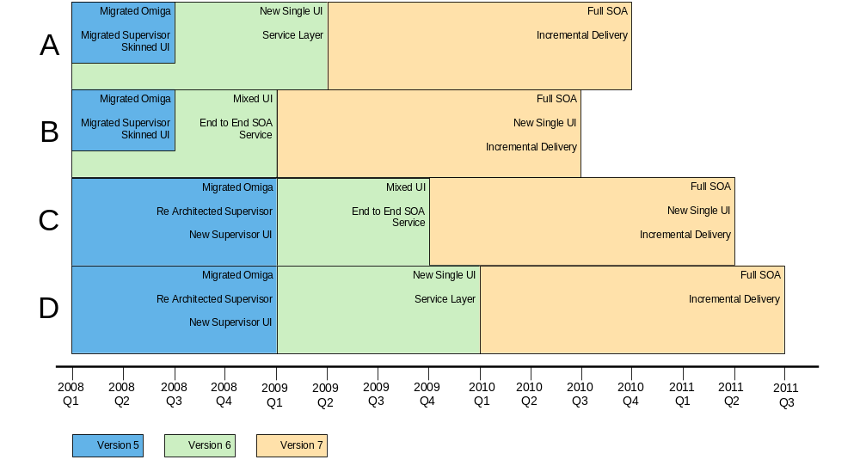
Illustrative Feature Timeline

Slide 15
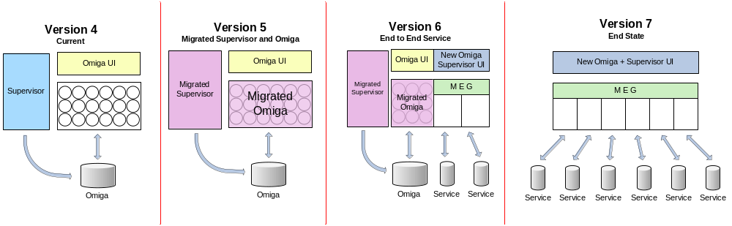
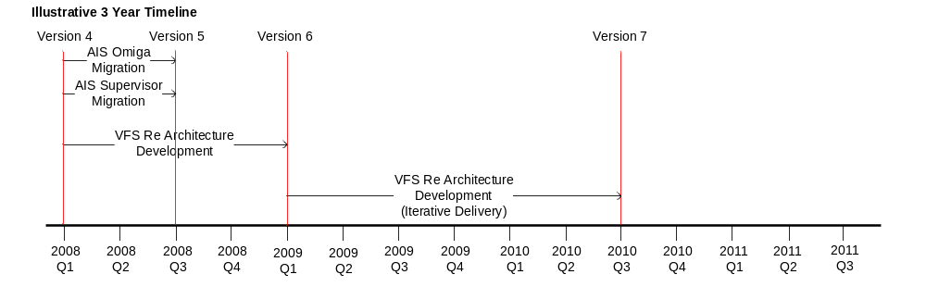
Option B

Slide 16
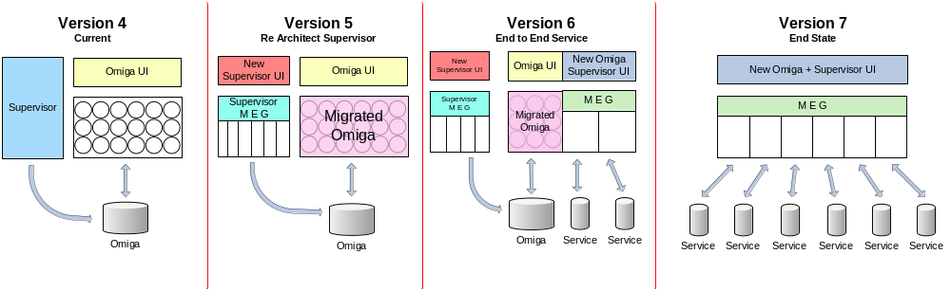
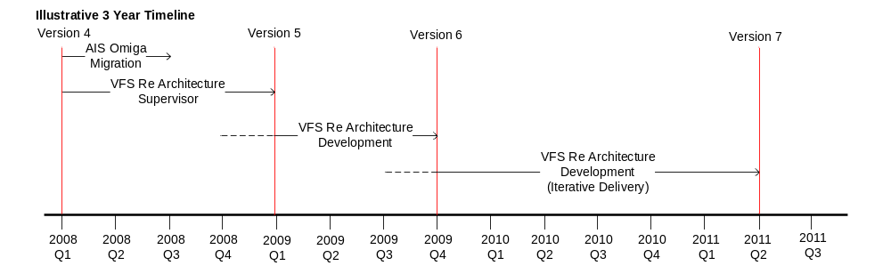
Option C

Slide 17
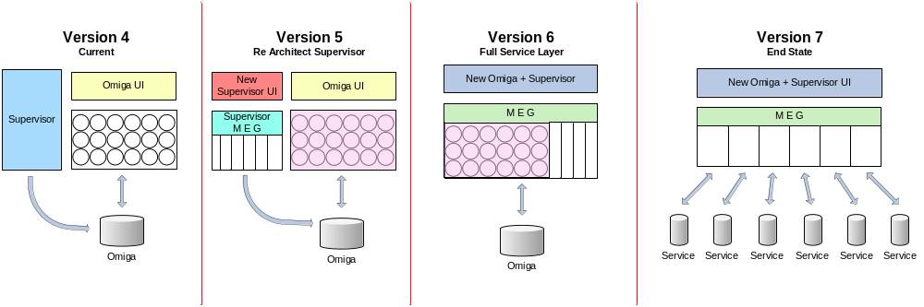
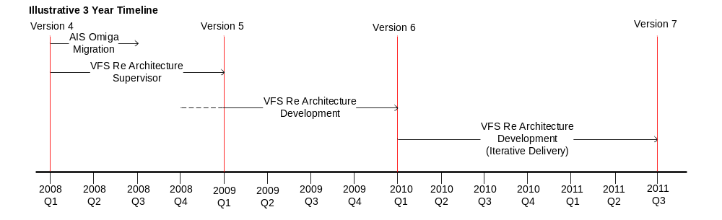
Option D

Slide 18
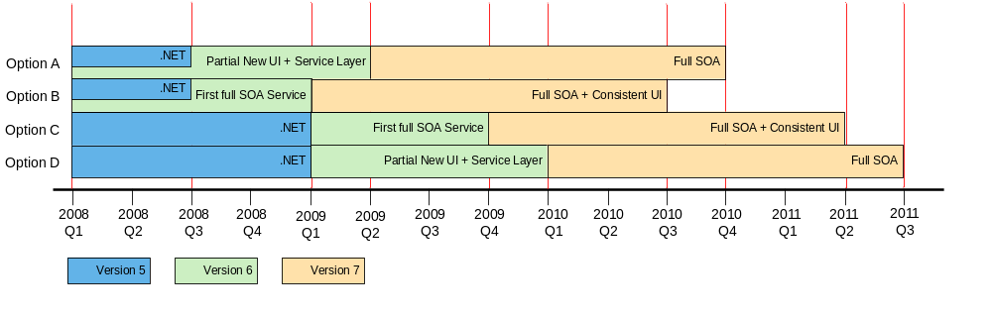
Illustrative Availability of Key Saleable Features

Slide 19
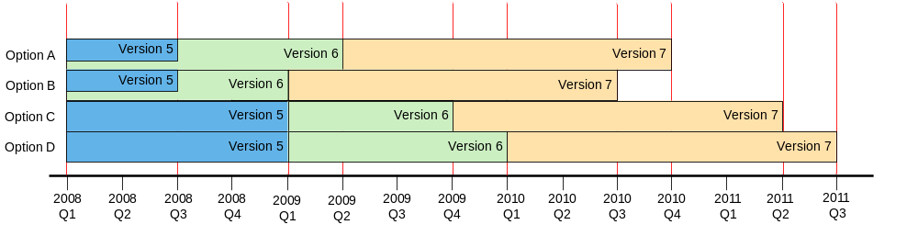
Illustrative Roadmap Option Timelines

Slide 20
Further Considerations
When to incorporate
  New Business functionality
      Generic Fee Sets
      Rate Loadings
      Tranche Management
  Business as Usual Changes
Build or buy subsystems

Slide 21
Estimated effort for Version 5 options
  5A Re Architect Supervisor – 1959 days
    1849 person days
    Excludes project management
    Excludes Supervisor UI
    100 days for infrastructure
    10 days face lift Omiga UI
  5B Migrate Supervisor – 218 days
    198 person days
    10 days skinned UI and single click deployment
    10 days face lift Omiga UI

Slide 22
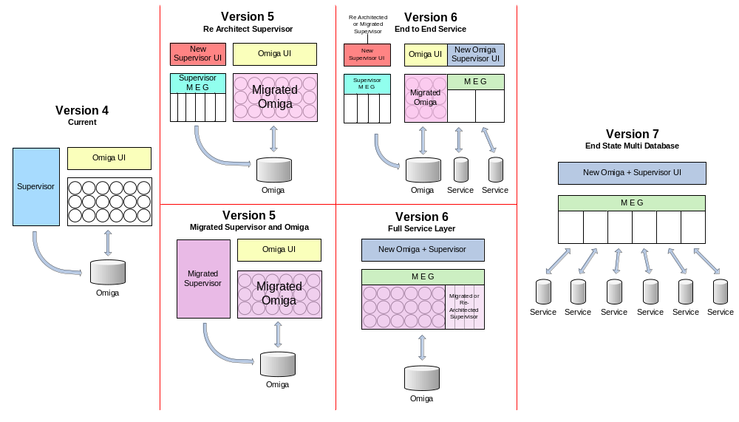
Options Overview

Slide 23
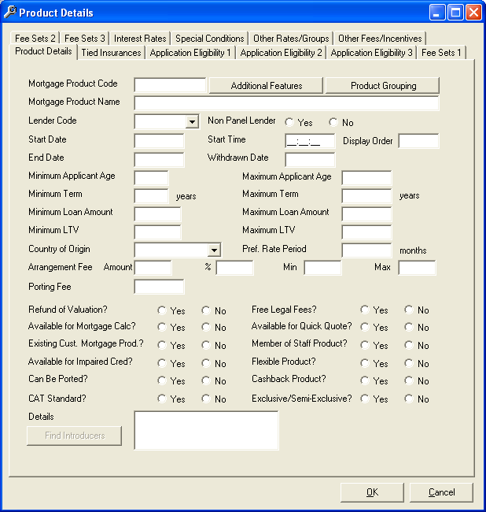
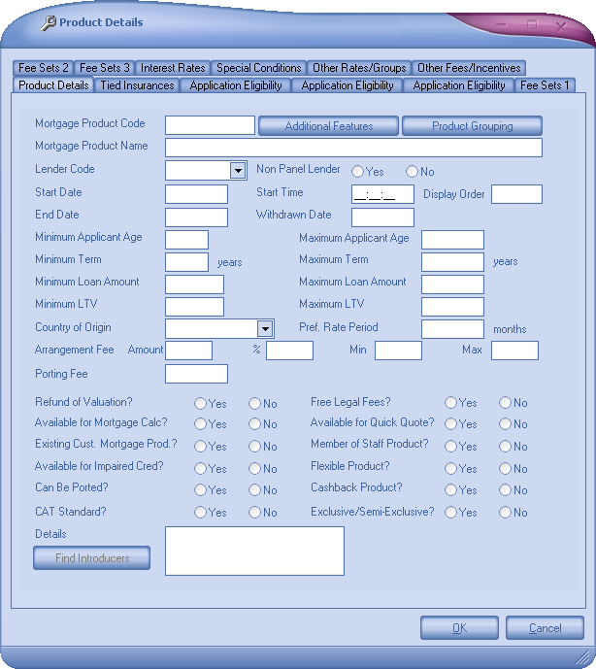
Sample Face Lift UI Supervisor

